Slide 1


Slide 2
Some words in English cause trouble for speakers and writers because these words share a similar pronunciation, meaning, or spelling with another word. These words are called commonly confused words.
They look alike, sound alike or, worst of all, look and sound alike but have completely different meanings. Other words look and sound different but are hard to determine which the correct one in a given context is.

Slide 3
For example, read aloud the following sentences containing the commonly confused words new and knew:
I liked her new sweater.
I knew she would wear that sweater today.
These words may sound alike when spoken, but they carry entirely different usages and meanings. New is an adjective that describes the sweater and knew is the past tense of the verb to know. New and knew are just two of the words that can be confusing because of their similarities.

Slide 4
CATEGORIES OF CONFUSING WORDS
Homonyms
Homonyms (homo meaning same and nym meaning name) are words that sound alike but are different in meaning. They can be spelled the same or differently. It’s important not to misuse homonyms, though, because the meaning of what you want to say can change drastically if you confuse the word’s meaning.
For example, if your friend tells you that he saw a murder on the way home from work, you’ll probably want to clarify whether he means that he witnessed a violent crime or whether he saw a group of crows.

Slide 5
Poll Question:-
__________ are words that are spelled alike and sound alike ,but can have different spellings.
Homophones
Homonyms
Homographs
Homosapiens

Slide 6
Answer -B

Slide 7
Homophones
There, their, and they’re are probably the most misused words in the English language. They’ve been misused on restaurant signs, in Internet comments, and across bumper stickers. What is it about these words that make their usage so tricky? The answer: they’re homophones.
Homophones (homo meaning same and phone meaning sound) are words that are pronounced the same but are different in meaning. They differ from homonyms because they are not spelled the same, as you can see in the example of there (indicating a place or idea), their (indicating possession), and they’re (indicating a contraction of they are).

Slide 8
Poll Question:-
Homophones are words that sound different but have same meanings. a) True b) False

Slide 9
Answer- b Explanation: The statement is false. Homophones are words that sound the same but have different meanings and spellings.

Slide 10
Homographs
Homographs (homo meaning same and graph meaning writing) differ from homonyms and homophones in that homographs are not pronounced the same. They are spelled the same, however, and are different in meaning. They are not so easily confused in spoken English, but they can be tricky to spot in written English.
Consider the word ‘bass’.
Bass
Bass is a type of fish.
Bass is also used for deep low-pitched voice.
Bass is also a genre for music.
The word bass is a homograph with different pronunciations and many different meanings.

Slide 11
Poll Question:-
________words that have the same spelling, but different pronunciations and meaning.
Homophones
Homonyms
Homographs
Homosapiens

Slide 12
Answer - C

Slide 13
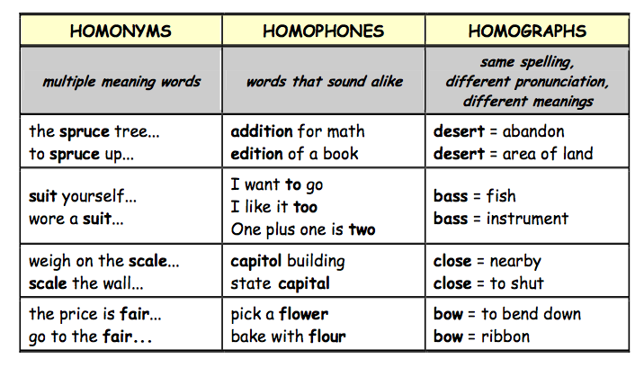
s

Slide 14
Examples

Slide 15
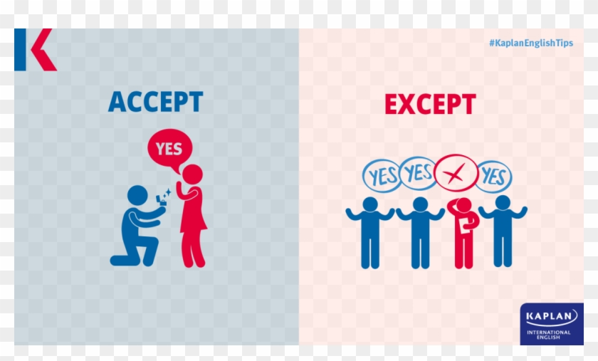
Accept, Except
Accept (verb). Means to take or agree to something offered.
They accepted our proposal for the conference.
Except (conjunction). Means only or but.
We could fly there except the tickets cost too much.

Slide 16
Poll Question
Everything was in good order ___________ the boots.
A. accept
B. except

Slide 17
Answer
OPTION- B

Slide 18
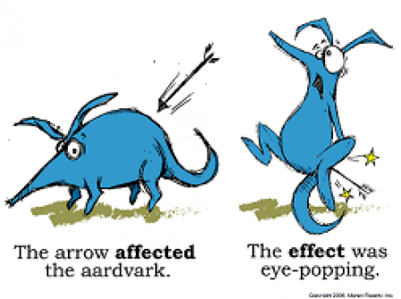
Affect, Effect
Affect (verb). Means to create a change.
Hurricane winds affect the amount of rainfall
Effect (noun). Means an outcome or result.
The heavy rains will have an effect on the crop growth.

Slide 19
Poll Question
The oil spill in the Gulf of Mexico has ……..the economy and the environment in negative ways.
A. affected
B. effected

Slide 20
Answer
Option-A

Slide 21
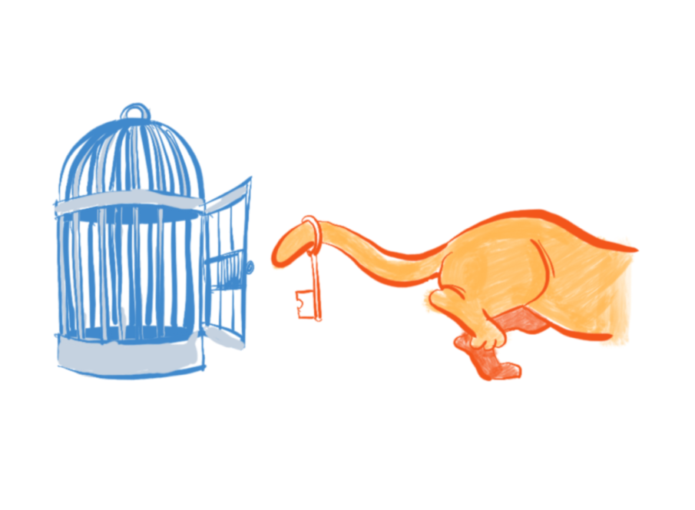
Its, It’s
Its (pronoun). A form of it that shows possession.
The butterfly flapped its wings.
It’s (contraction). Joins the words it and is.
It’s the most beautiful butterfly I have ever seen.

Slide 22
Poll Question
The dog buried ……. bone.
A. its
B. it’s

Slide 23
Answer
OPTION-A

Slide 24
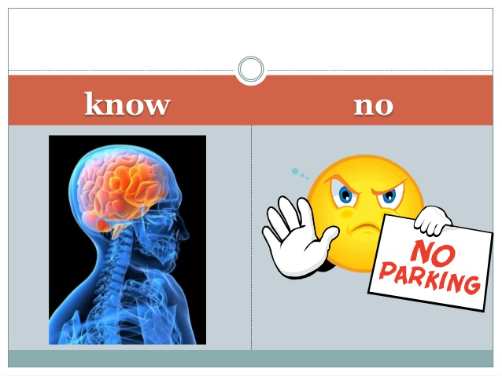
Know, No
Know (verb). Means to understand or possess knowledge.
I know the male peacock sports the brilliant feathers.
No. Used to make a negative.
I have no time to visit the zoo this weekend.

Slide 25
Poll Question
I ________ you must be tired, so I will let you rest.
A. know
B. no

Slide 26
Answer
OPTION- A

Slide 27
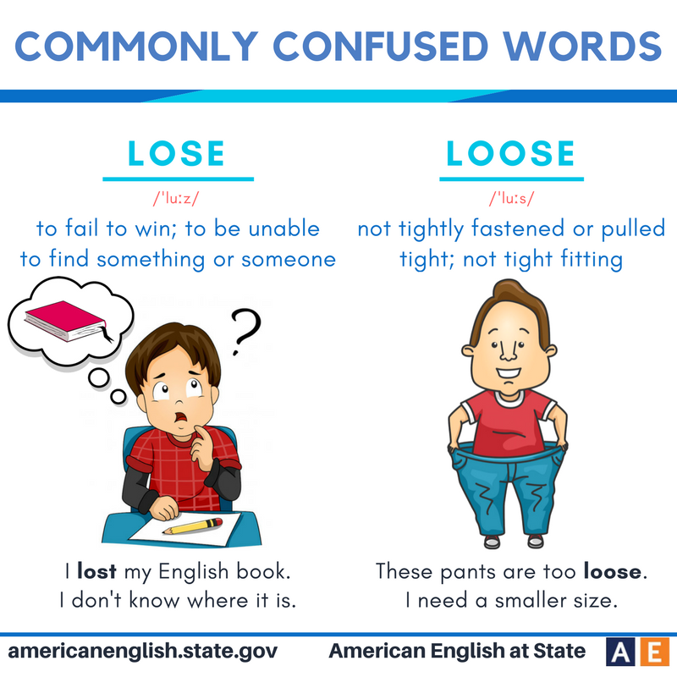
Loose, Lose
Loose (adjective). Describes something that is not tight or is detached.
Without a belt, her pants are loose on her waist.
Lose (verb). Means to forget, to give up, or to fail to earn something.
She will lose even more weight after finishing the marathon training.

Slide 28
Poll Question
Did you …….. your glasses again?
A. lose
B. loose

Slide 29
Answer
OPTION- A

Slide 30

Quiet, Quiet, Quit
Quite (adverb). Means really or truly.
My work will require quite a lot of concentration.
Quiet (adjective). Means not loud.
I need a quiet room to complete the assignments.
Quit (verb). Means to stop or to end.
I will quit when I am hungry for dinner.

Slide 31
Poll Question
. I wish I had seen the show last night, I heard it was ……….. a performance.
A. quiet
B. quite

Slide 32
Answer
OPTION - B

Slide 33
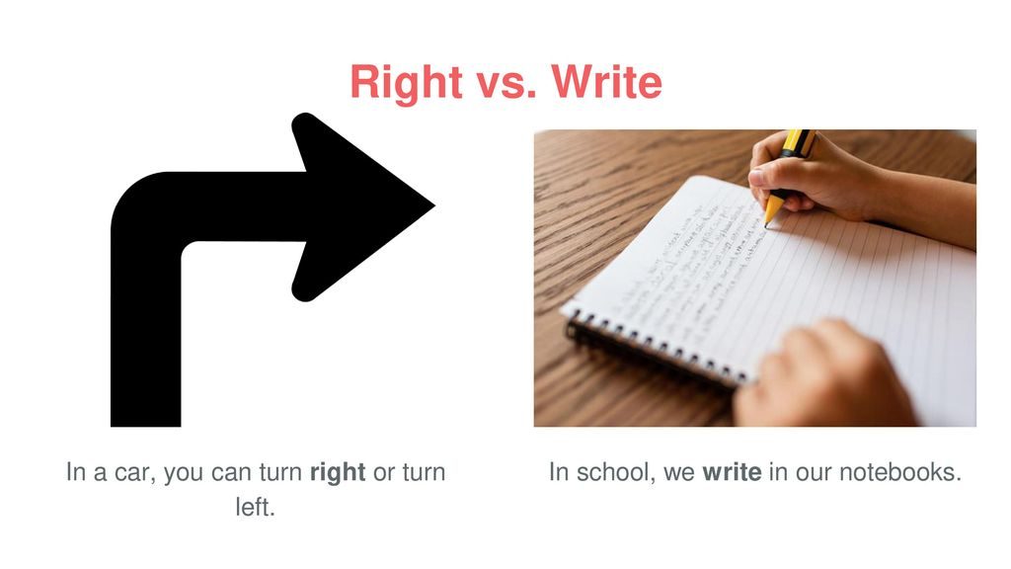
Right, Write
Right (adjective). Means proper or correct.
When bowling, she practices the right form.
Right (adjective). Also means the opposite of left.
The ball curved to the right and hit the last pin.
Write (verb). Means to communicate on paper.
After the team members bowl, I will write down their scores.

Slide 34
Poll Question
I don’t know If I made the __________decision.
A. write
B. rite
C. right

Slide 35
Answer
OPTION- C

Slide 36
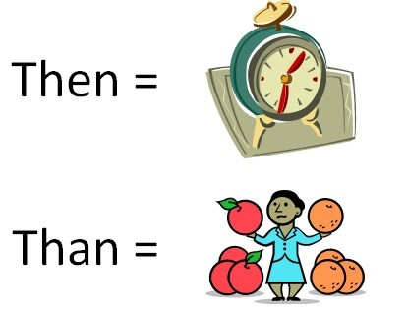
Than, Then
Than (conjunction). Used to connect two or more items when comparing
Registered nurses require less schooling than doctors.
Then (adverb). Means next or at a specific time.
Doctors first complete medical school and then obtain a residency.

Slide 37
Poll Question
I wanted to go home more ……… I wanted to go to the party.
A. than
B. then

Slide 38
Answer
OPTION- A

Slide 39
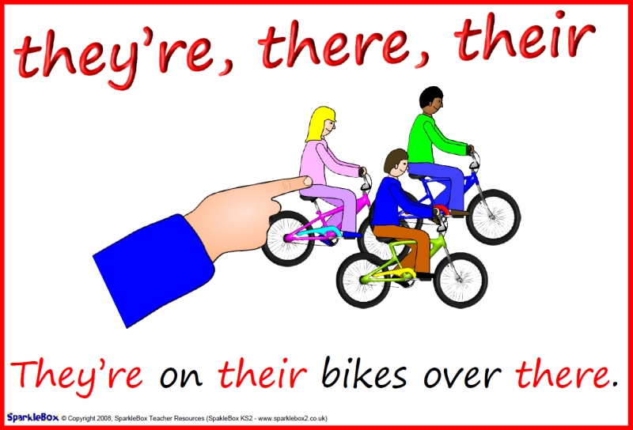
Their, They’re, There
Their (pronoun). A form of they that shows possession.
The dog walker feeds their dogs everyday at two o’clock.
They’re (contraction). Joins the words they and are.
They’re the sweetest dogs in the neighborhood.
There (adverb). Indicates a particular place.
The dogs’ bowls are over there, next to the pantry.
There (pronoun). Indicates the presence of something
There are more treats if the dogs behave.

Slide 40
Poll Question
Just put it over ……...
A. their
B. there

Slide 41
Answer
OPTION- B

Slide 42
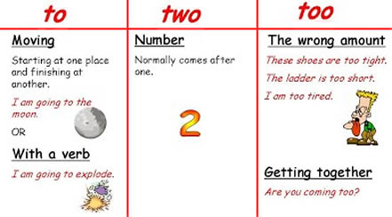
To, Two, Too
To (preposition). Indicates movement.
Let’s go to the circus.
To. A word that completes an infinitive verb.
to play, to ride, to watch.
Two. The number after one. It describes how many.
Two clowns squirted the elephants with water.
Too (adverb). Means also or very.
The tents were too loud, and we left.

Slide 43
Poll Question
Are you coming with us _____?
a. too
b. to
c. two

Slide 44
Answer
OPTION- A

Slide 45
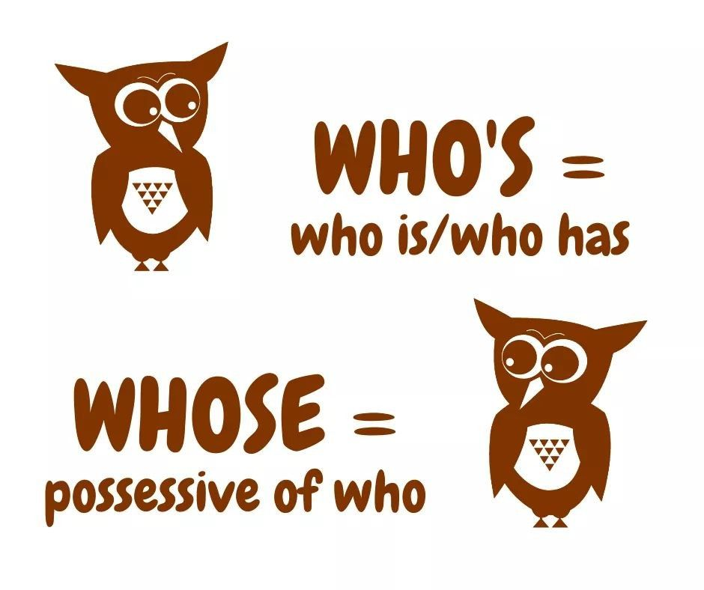
Who’s, Whose
Who’s (contraction). Joins the words who and either is or has.
Who’s the new student? Who’s met him?
Whose (pronoun). A form of who that shows possession.
Whose schedule allows them to take the new student on a campus tour?

Slide 46
Poll Question
Anyone ……….. been to Wales knows how beautiful the countryside is.
A. whose
B. who’s

Slide 47
Answer
OPTION- B

Slide 48
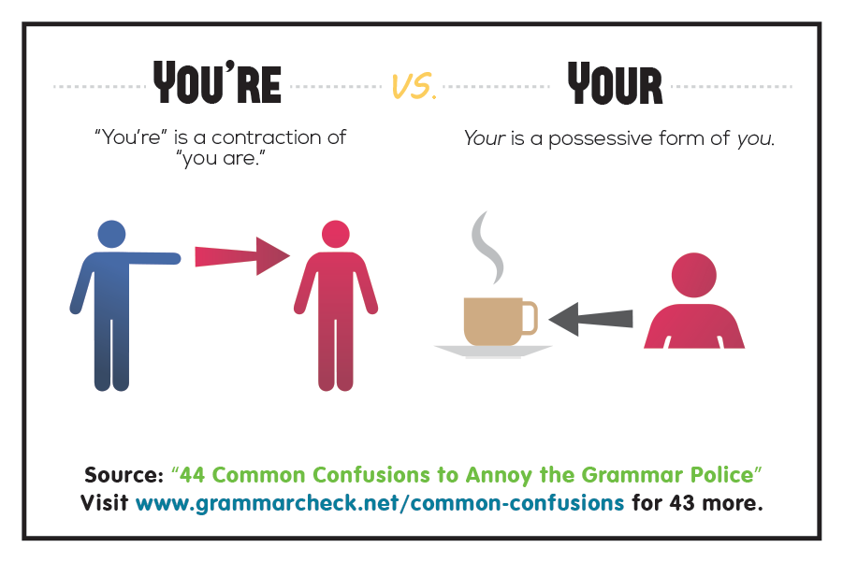
Your, You’re
Your (pronoun). A form of you that shows possession.
Your book bag is unzipped.
You’re (contraction). Joins the words you and are.
You’re the girl with the unzipped book bag.

Slide 49
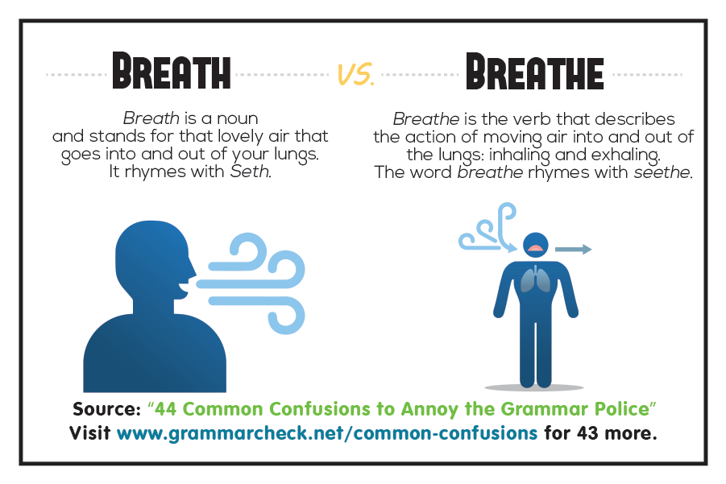
Breath ,Breathe
Breath (noun)- the air that goes into and out of your lungs:
Her breath smelled of garlic.
Breathe ( verb)-to move air into and out of the lungs:
I'm sorry if I'm breathing garlic fumes all over you!

Slide 50
Poll Question
Fish cannot ______ out of water.
a. breath
b. breathe

Slide 51
Answer
OPTION - B

Slide 52
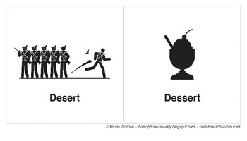
Desert, Dessert
Desert ( noun)- to leave somebody or something.
How many people desert from the army each year?
Dessert (noun)- sweet food eaten at the end of a meal.
He had apple pie with ice cream for dessert.

Slide 53
Poll Question
Fruit makes a healthy …….. after lunch or dinner.
A. desert
B. dessert

Slide 54
Answer
OPTION- B

Slide 55
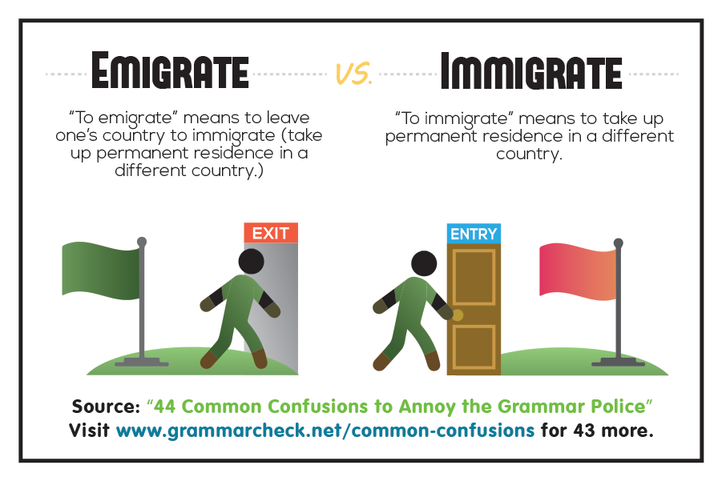
Emigrate, Immigrate
Emigrate (verb)- to leave a country permanently and go to live in another one:
to leave a country permanently and go to live in another one:
Immigrate(verb) -to come to live in a different country:
He immigrated with his parents in 1895 and grew up on Long Island.

Slide 56
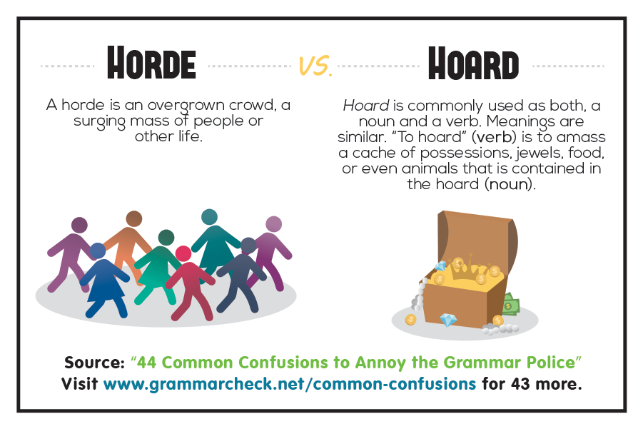
Horde, Hoard
Horde (noun)-a large group of people:
Hordes of students on bikes made crossing the road difficult.
Hoard (verb)-to collect large amounts of something and keep it for yourself, often in a secret place:
No one suspected that the simple old woman’s attic held a hoard of rare gold coins.

Slide 57
Poll Question
A _______ of tourists entered the museum.
A. hoard
B. horde

Slide 58
Answer
OPTION- B

Slide 59
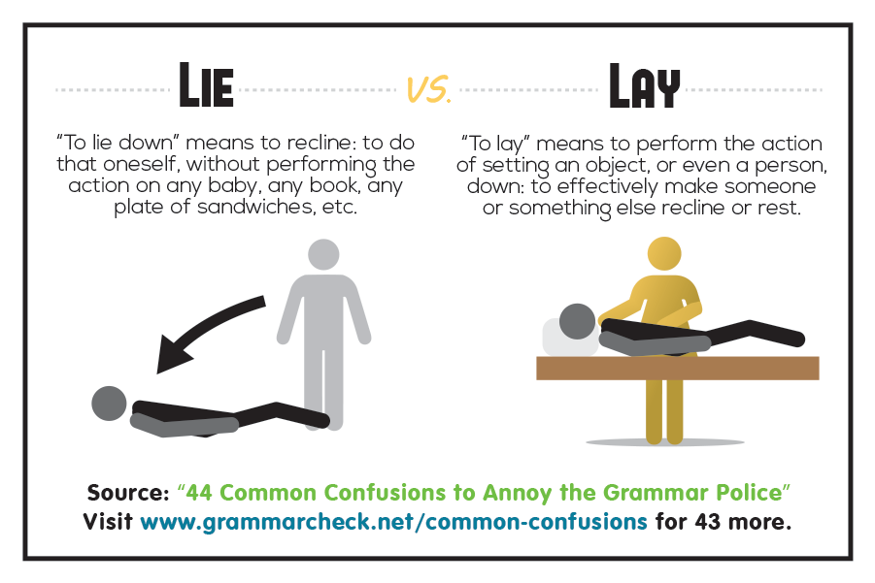
Lie, Lay
Lie (verb)-to be in or move into a horizontal position on a surface:
I think I’ll lie down for a little nap.
Lay (verb)- to put something in especially a flat or horizontal position, usually carefully or for a particular purpose:
I think I’ll lay my book down next to me before my nap.

Slide 60
Poll Question
Whatever happens, do not ………. your weapon!
A. lie down
B. lay down

Slide 61
Answer
OPTION- B

Slide 62
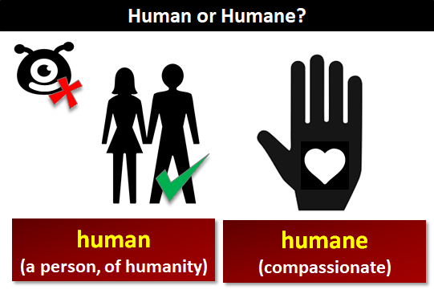
Human, Humane
Human(adj) –person - When he laughs it makes him seem more human.
Humane (adj) - feeling or displaying worry about the misery of another- Our treatment must be humane to the poor. poor.

Slide 63
Poll Question
Not that I am less _______ than others, but I did not perceive that my feelings were much affected.
A. humane
B. human

Slide 64
Answer
OPTION- A

Slide 65
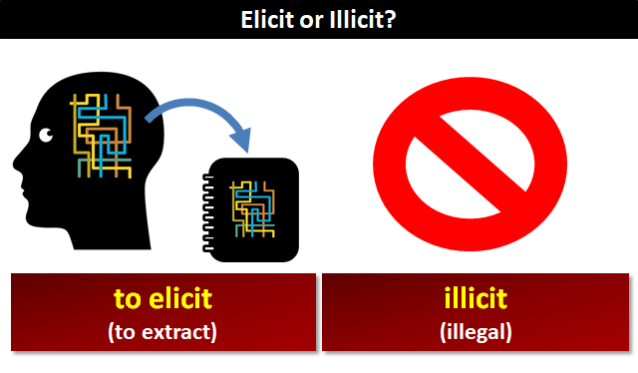
Elicit, illicit
Elicit (verb)- to get something ,esp. information or reaction.
Have you managed to elicit a response from them yet?
Illicit (adj)- illegal or disapproved of by society.
I dumped my friend because of his illicit drug habit.

Slide 66
Poll Question
The teacher ……… answers from the students.
A. illicited
B. elicited

Slide 67
Poll Question
OPTION- B

Slide 68
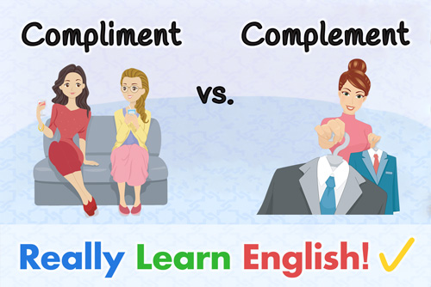
Complement, Compliment
Complement (verb) - to make something else seem better or more attractive when combining with it:
The music complements her voice perfectly.
Compliment (noun)-a remark that expresses approval, admiration respect.
I just wanted to compliment you for the wonderful speech you gave tonight.

Slide 69
Poll Question
The teacher _______ the boy on his success.
a. complimented b. complemented

Slide 70
Answer
OPTION-A

Slide 71
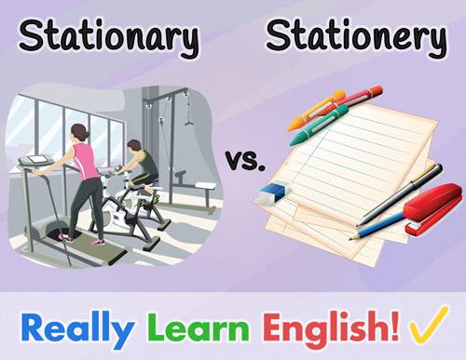
Stationary, Stationery
Stationary( adj)- not changing
I just wanted to compliment you for the wonderful speech you gave tonight..
Stationery (noun)- the things needed for writing ,such as paper, pens, pencils and envelopes.
I got these folders at the stationery store.

Slide 72
Poll Question
My grandmother has given me a lot of ……….. over the years. I think she wants me to use it to write her.
A. stationary
B. stationery

Slide 73
Answer
OPTION- B

Slide 74
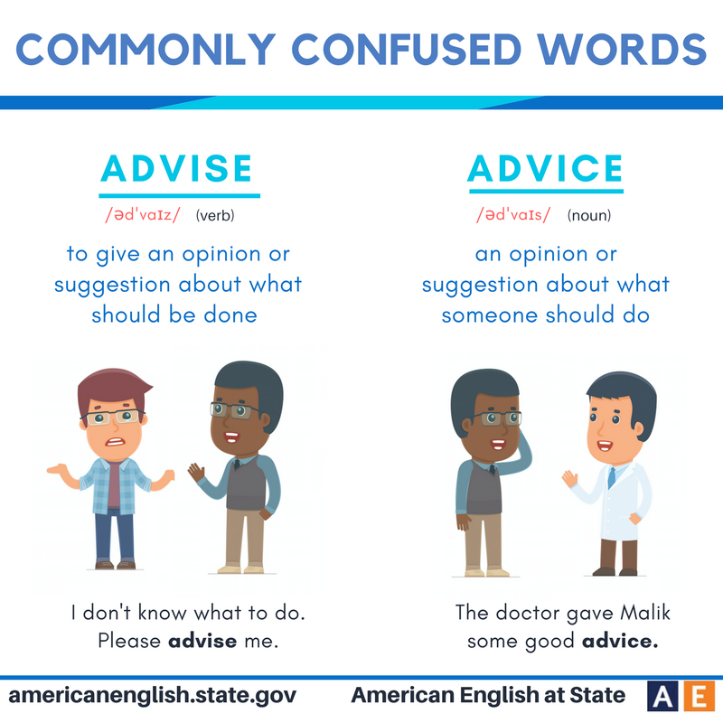
Advise, Advice
Advise ( verb) - to offer suggestions to a person or group
At the meeting, the school counselor will advise me on some of my career options.
Advice (noun)- an opinion that someone offers you about what you should do or how you should act in a particular situation:
Steven gave me some good advice.

Slide 75
Poll Question
It is easy to give …………, but not so easy to take it.
A. advice
B. advise

Slide 76
Answer
OPTION- A

Slide 77
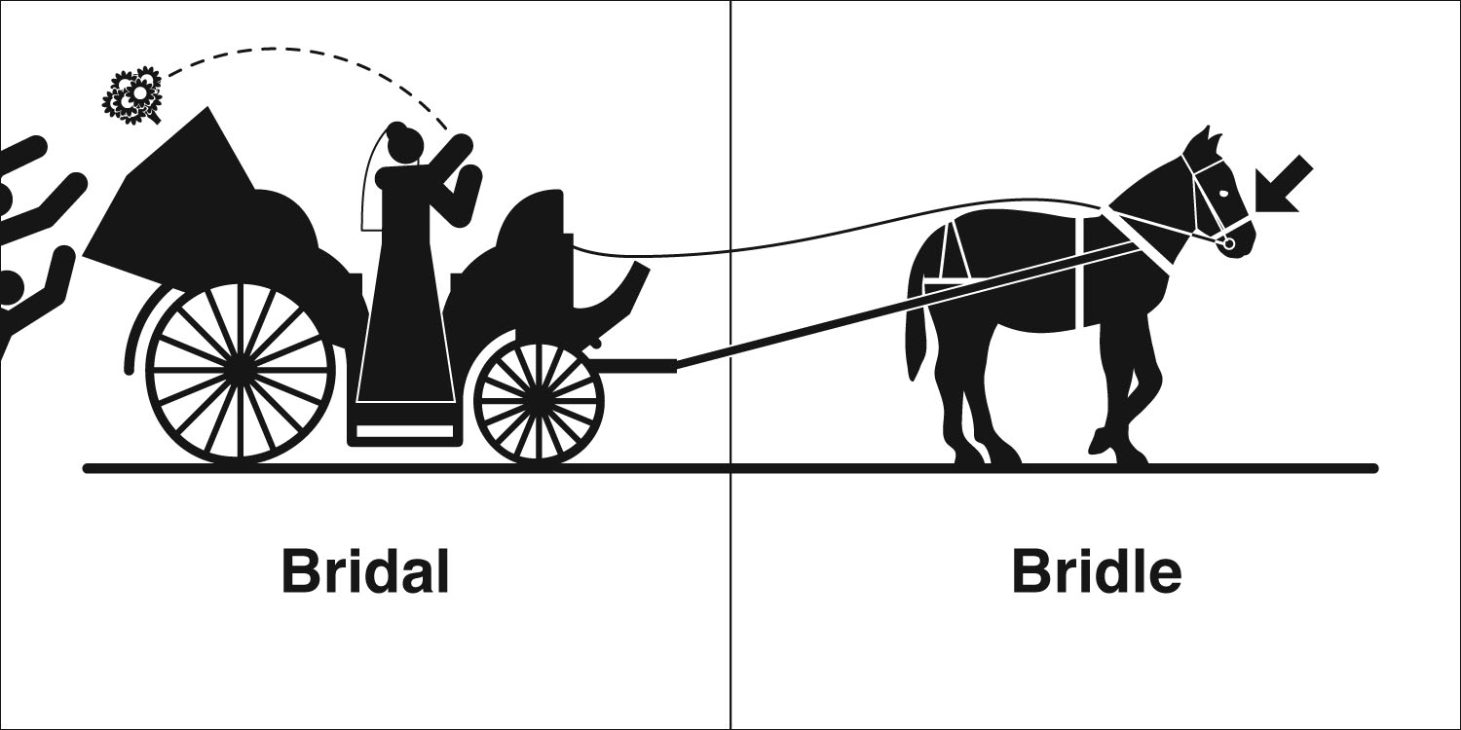
Bridal , Bridle
Bridal (adj) - of a woman about to be married
The magazine had a section on bridal wear.
Bridle (noun)- a set of leather straps that are put around a horse's head to allow its rider to control it
As soon as she jerked his bridle, the horse reared back again and kicked.

Slide 78
Poll Question
Choose if the given sentence is correct or incorrect.
Petya held his horse by the bridal, impatiently awaiting the order to mount.
Correct
Incorrect

Slide 79
Answer
Option- A

Slide 80
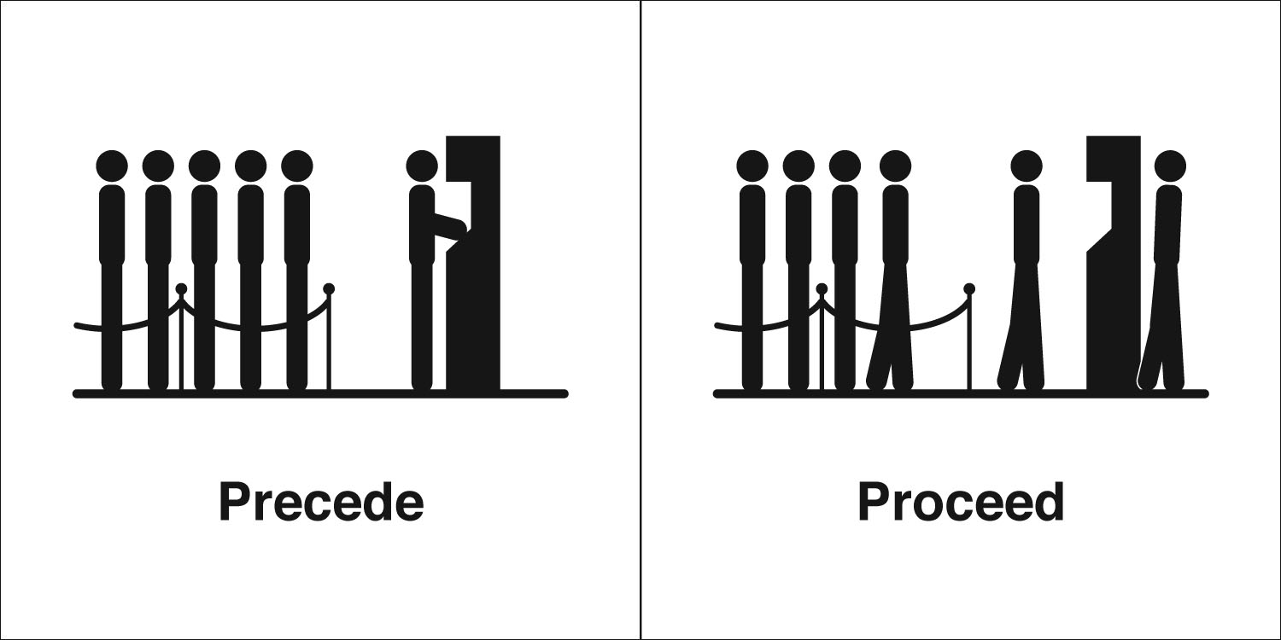
Proceed, Precede
Proceed ( verb)- to continue as planned
His lawyers have decided not to proceed with the case.
Precede (verb)- to go before someone or something in time or space.
Nouns are often preceded by adjectives.

Slide 81
Poll Question
The election of a new president …….. his inauguration.
A. proceeds
B. precedes

Slide 82
Answer
OPTION- B

Slide 83
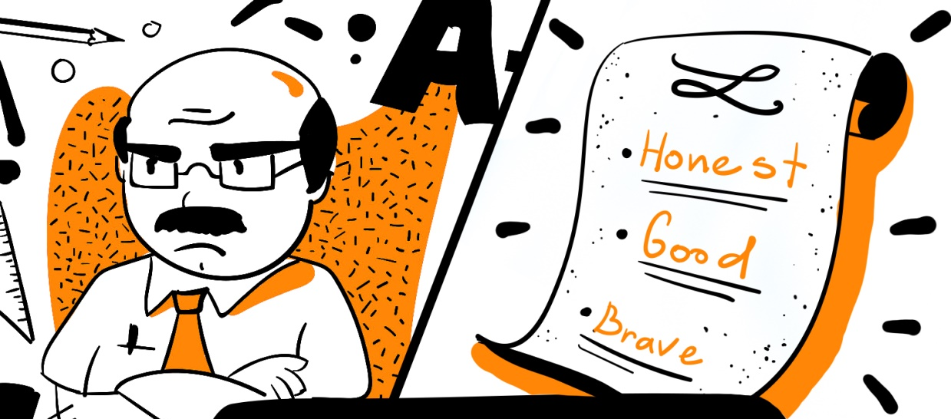
Principal, Priniciple
Principal (adj)- the person in-charge of a school.
Our principal works very hard.
Principle (noun)- a basic idea or rule that explains or controls how something happens or works:
a basic idea or rule that explains or controls how something happens or works:

Slide 84
Poll Question
Not everybody shares my ………….
A. principles
B. principals

Slide 85
Answer
OPTION- A

Slide 86
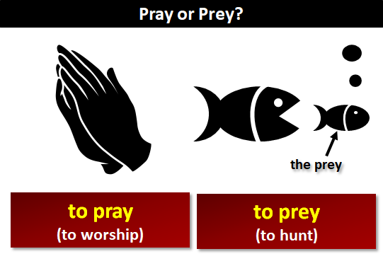
Pray. Prey
Pray (verb)- to speak to God in order to give thanks or to ask for help.
They knelt down and prayed for peace
Prey (noun)- an animal that is hunted and killed for food by another animal:
an animal that is hunted and killed for food by another animal:

Slide 87
Poll Question
What is the meaning of the word ‘Prey’?
A. an animal or bird that is killed and eaten by another animal or bird
B. to speak to God

Slide 88
Answer
OPTION-A

Slide 89
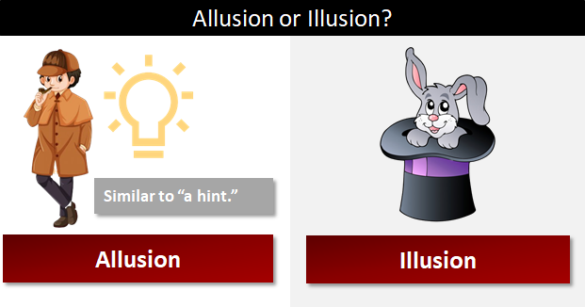
Allusion, Illusion
Allusion (noun)- An allusion is a subtle reference or hint.
The film is full of allusions to Hitchcock..
Illusion (noun)- an idea or belief that is not true:
My boss is labouring under the illusion that the project will be completed on time.

Slide 90
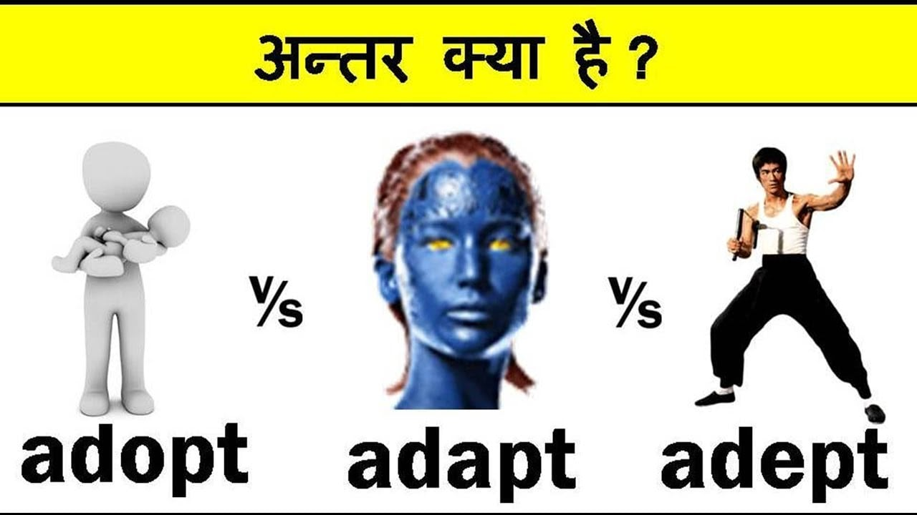
Adopt, Adapt, Adept
Adopt (verb)- o "accept as your own":
It was difficult to adopt only one puppy from the animal shelter
Adapt (verb)-to adjust- The bus was adapted for disabled people.
Adept (adj)-skillful at something
She is very adept at dealing with media.

Slide 91
Poll Question
Which sentence is correct ?
A. He is unusually adept in mathematical calculations.
B. He is unusually adapt in mathematical calculations.
C. He is unusually adopt in mathematical calculations

Slide 92
Answer
OPTION- A.

Slide 93
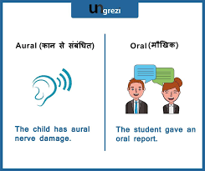
Oral, Aural
Oral (adj)-spoken, not written
I’ve got my geography oral next week.
Aural (adj)- relating to hearing
She doesn’t speak English well, but her aural comprehension is good.

Slide 94
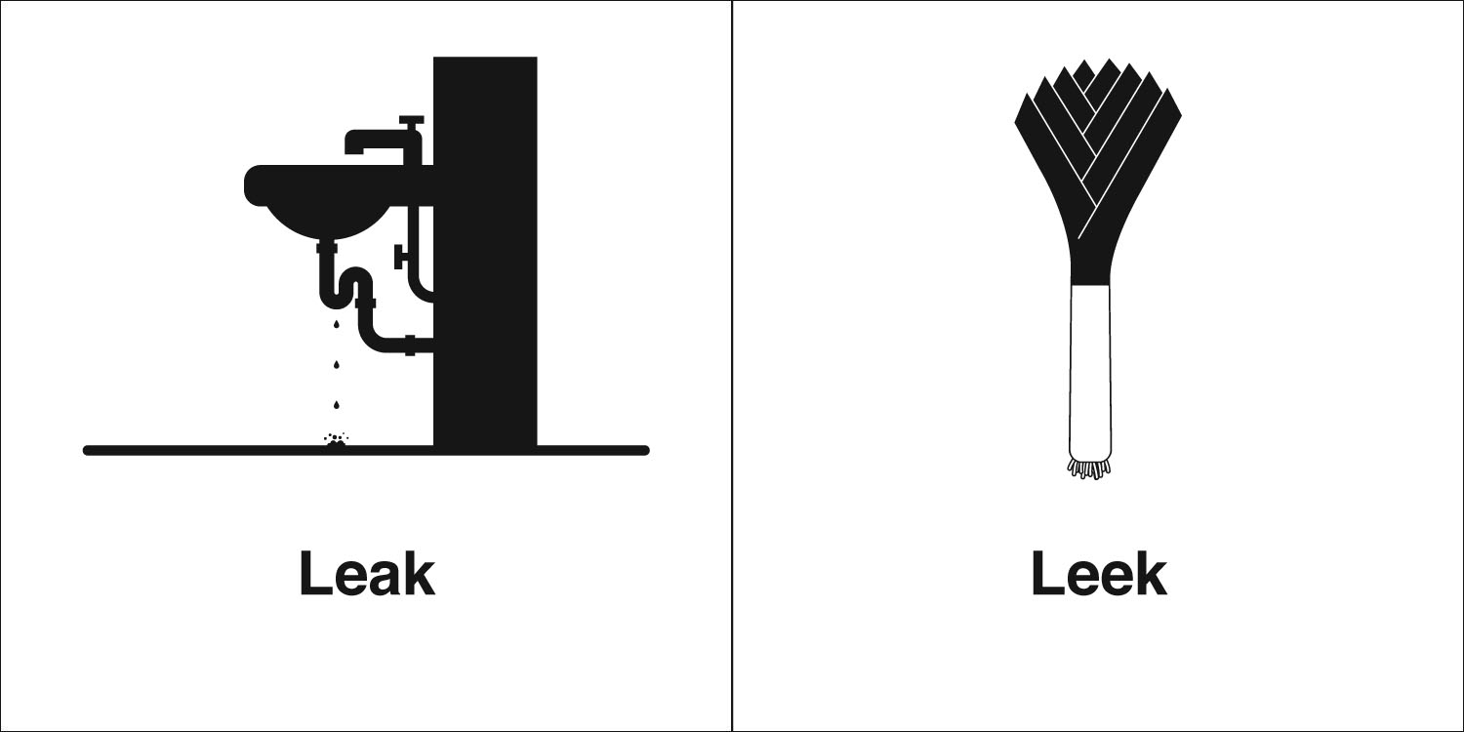
Leak, Leek
Leak (verb)- to allow liquid or gas to get through a hole or crack
Water is leaking in through the roof..
Leek (noun) - a long thin vegetable that is white at one end with thin green leaves
For a first course, there is a potato leek soup.

Slide 95
Poll Question
Which sentence is correct?
A. If you enjoy a 5.1 surround sound system, the aural experience is equally impressive.
B. If you enjoy a 5.1 surround sound system, the oral experience is equally impressive.

Slide 96
Answer
OPTION-A

Slide 97
“Practice daily because the quality of your practice determines the caliber of your performance….”
THANK YOU

